Slide 1
IT694 Computer Networks
Week13_Lec1

Slide 2
Link layer, LANs: roadmap
introduction
error detection, correction
multiple access protocols
LANs
addressing, ARP
Ethernet
switches
VLANs

Slide 3
















Link layer: introduction
terminology:
hosts, routers: nodes
communication channels that connect adjacent nodes along communication path: links
wired , wireless
LANs
layer-2 packet: frame, encapsulates datagram
mobile network
national or global ISP
datacenter
network
link layer has responsibility of
transferring datagram from one node
to physically adjacent node over a link
enterprise
network

Slide 4


Link layer: services
framing, link access:
encapsulate datagram into frame, adding header, trailer
channel access if shared medium
“MAC” addresses in frame headers identify source, destination (different from IP address!)
reliable delivery between adjacent nodes
…
…
Cable access
cellular
Ethernet LANs
WiFi
Notes:
reliable delivery between adjacent nodes
Not always
Rdt likes we studied in transport layer
Reliable is not as important is correctness. How is correctness assured?
Wireless is subjected to noise, interference and has high bit error rate.
Why

Slide 5
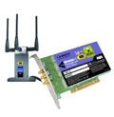
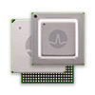

Host link-layer implementation
in each-and-every host
link layer implemented on-chip or in network interface card (NIC)
implements link, physical layer
attaches into host’s system buses
combination of hardware, software, firmware
application
transport
network
link
cpu
memory
host bus
(e.g., PCI)
controller
link
physical
physical
network interface
Notes:
The Ethernet capabilities are either integrated into the motherboard chipset or implemented via a low-cost dedicated Ethernet chip. For the most part, the link layer is implemented on a chip called the network adapter, also sometimes known as a network interface controller (NIC). The network adapter implements many link layer services including framing, link access, error detection, and so on. Thus, much of a link-layer controller’s functionality is implemented in hardware. For example, Intel’s 700 series adapters [Intel 2020] implements the Ethernet protocols we’ll study in Section 6.5; the Atheros AR5006 [Atheros 2020] controller implements the 802.11 WiFi protocols we’ll study in Chapter 7.
Figure 6.2 shows that while most of the link layer is implemented in hardware, part of the link layer is implemented in software that runs on the host’s CPU. The software components of the link layer implement higher-level link-layer functionality such as assembling link-layer addressing information and activating the controller hardware. On the receiving side, link-layer software responds to con- troller interrupts (for example, due to the receipt of one or more frames), handling error conditions and passing a datagram up to the network layer. Thus, the link layer is a combination of hardware and software

Slide 6
Interfaces communicating
application
transport
network
link
application
transport
network
link
cpu
memory
memory
CPU
datagram
link_{h}
datagram
controller
controller
datagram
link_{h}
link
physical
link
physical
physical
physical
sending side:
encapsulates datagram in frame
adds error checking bits, reliable data transfer, flow control, etc.
receiving side:
looks for errors, reliable data transfer, flow control, etc.
extracts datagram, passes to upper layer at receiving side

Slide 7



Multiple access links, protocols
two types of “links”:
point-to-point
point-to-point link between Ethernet switch, host
PPP for dial-up access
broadcast (shared wire or medium)
old-school Ethernet
upstream HFC in cable-based access network
802.11 wireless LAN, 4G/4G. satellite
shared wire (e.g.,
cabled Ethernet)
shared radio: 4G/5G
shared radio: WiFi
shared radio: satellite
humans at a cocktail party
(shared air, acoustical)

Slide 8
Multiple access protocols
single shared broadcast channel
two or more simultaneous transmissions by nodes: interference
collision if node receives two or more signals at the same time
multiple access protocol
distributed algorithm that determines how nodes share channel, i.e., determine when node can transmit
communication about channel sharing must use channel itself!
no out-of-band channel for coordination

Slide 9
MAC protocols: taxonomy
three broad classes:
channel partitioning
divide channel into smaller “pieces” (time slots, frequency, code)
allocate piece to node for exclusive use
random access
channel not divided, allow collisions
“recover” from collisions
“taking turns”
nodes take turns, but nodes with more to send can take longer turns

Slide 10
Channel partitioning MAC protocols: TDMA
TDMA: time division multiple access
access to channel in “rounds”
each station gets fixed length slot (length = packet transmission time) in each round
unused slots go idle
example: 6-station LAN, 1,3,4 have packets to send, slots 2,5,6 idle
6-slot
frame
6-slot
frame
1
3
4
1
3
4

Slide 11
Channel partitioning MAC protocols: FDMA
FDMA: frequency division multiple access
channel spectrum divided into frequency bands
each station assigned fixed frequency band
unused transmission time in frequency bands go idle
example: 6-station LAN, 1,3,4 have packet to send, frequency bands 2,5,6 idle
time
frequency bands
FDM cable

Slide 12
Random access protocols
when node has packet to send
transmit at full channel data rate R
no a priori coordination among nodes
two or more transmitting nodes: “collision”
random access protocol specifies:
how to detect collisions
how to recover from collisions (e.g., via delayed retransmissions)
examples of random access MAC protocols:
ALOHA, slotted ALOHA
CSMA, CSMA/CD, CSMA/CA

Slide 13
CSMA (carrier sense multiple access)
simple CSMA: listen before transmit:
if channel sensed idle: transmit entire frame
if channel sensed busy: defer transmission
human analogy: don’t interrupt others!
CSMA/CD: CSMA with collision detection
collisions detected within short time
colliding transmissions aborted, reducing channel wastage
collision detection easy in wired, difficult with wireless
human analogy: the polite conversationalist

Slide 14
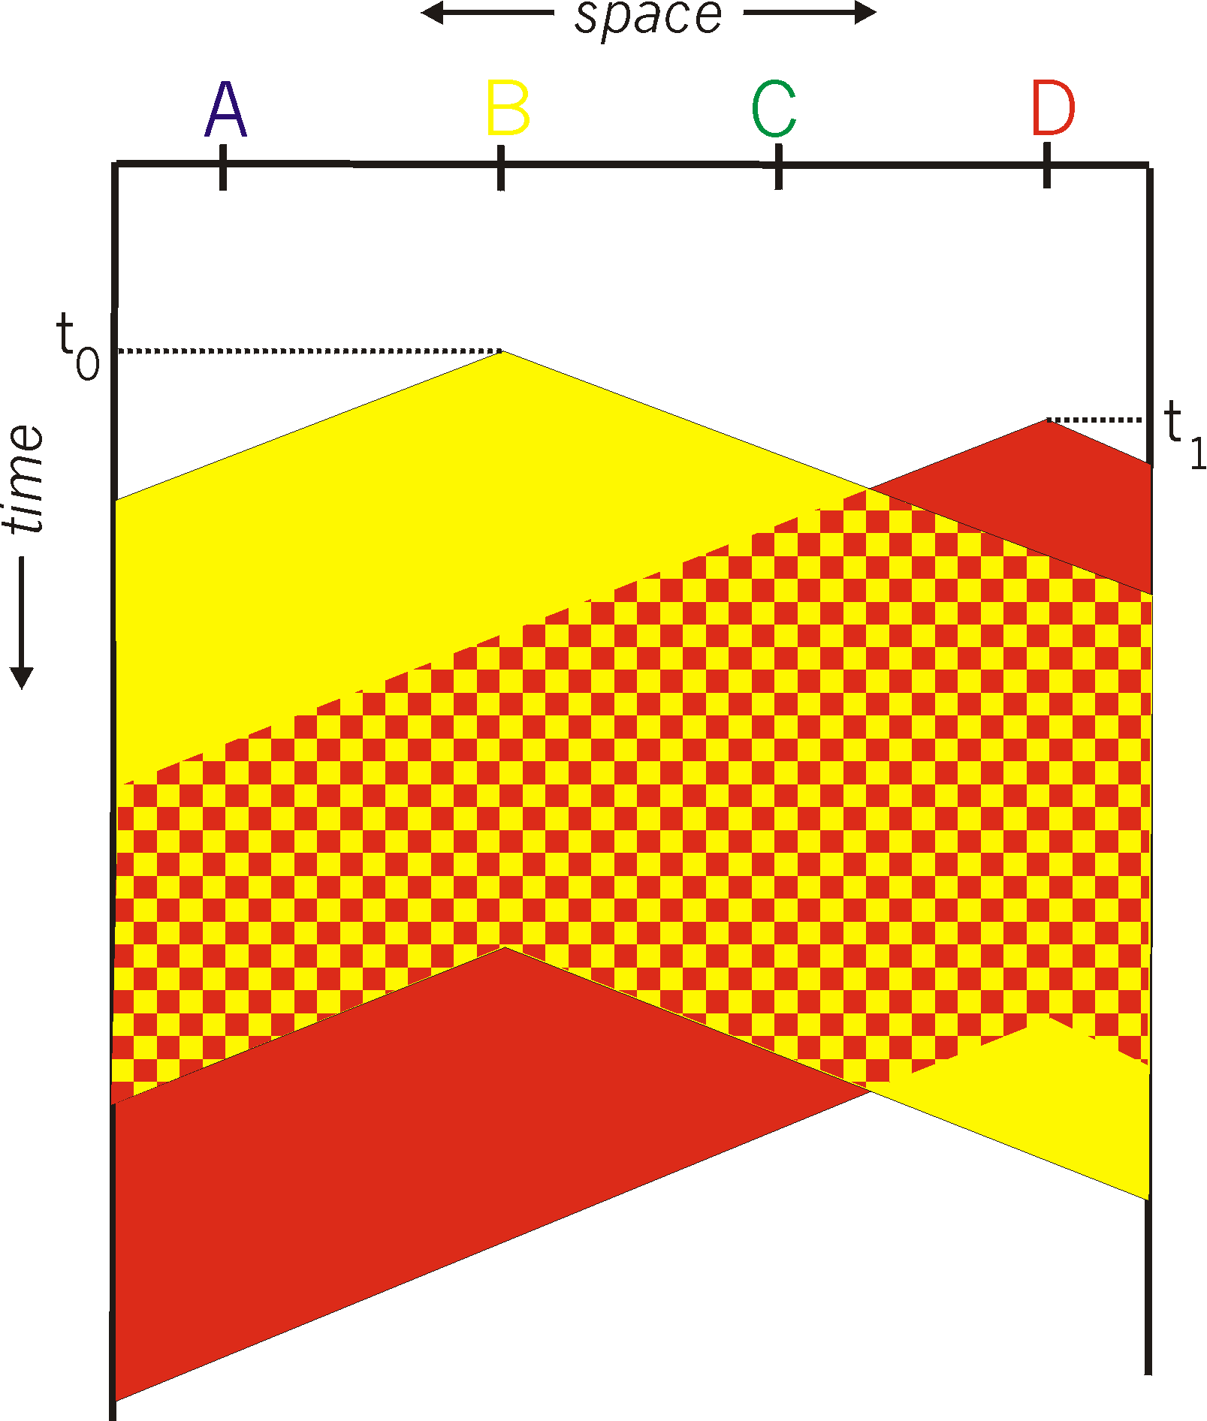
CSMA: collisions
spatial layout of nodes
collisions can still occur with carrier sensing:
propagation delay means two nodes may not hear each other’s just-started transmission
collision: entire packet transmission time wasted
distance & propagation delay play role in in determining collision probability

